Slide 1
Introduction to Cloud Computing
CSE-6305 Cloud Computing
Professor Dr. Mohammad Abdur Rouf

Slide 2
Class Administration
Lecture Material is available:
https://sites.google.com/a/duet.ac.bd/marouf-cse/courses-2018/cse-6305-cloud-computing
Marks Distribution
Attendance: 10%
Midterm/Homework: 20%
Final Exam: 70%
Text Book:
Will be provided during lecture
Email: marouf.cse@duet.ac.bd, rouf7606@gmail.com

Slide 3
Agenda
What is Cloud Computing ?
Different perspectives
Properties and characteristics
Benefits from cloud computing
Service and deployment models
Three service models
Four deployment models

Slide 4
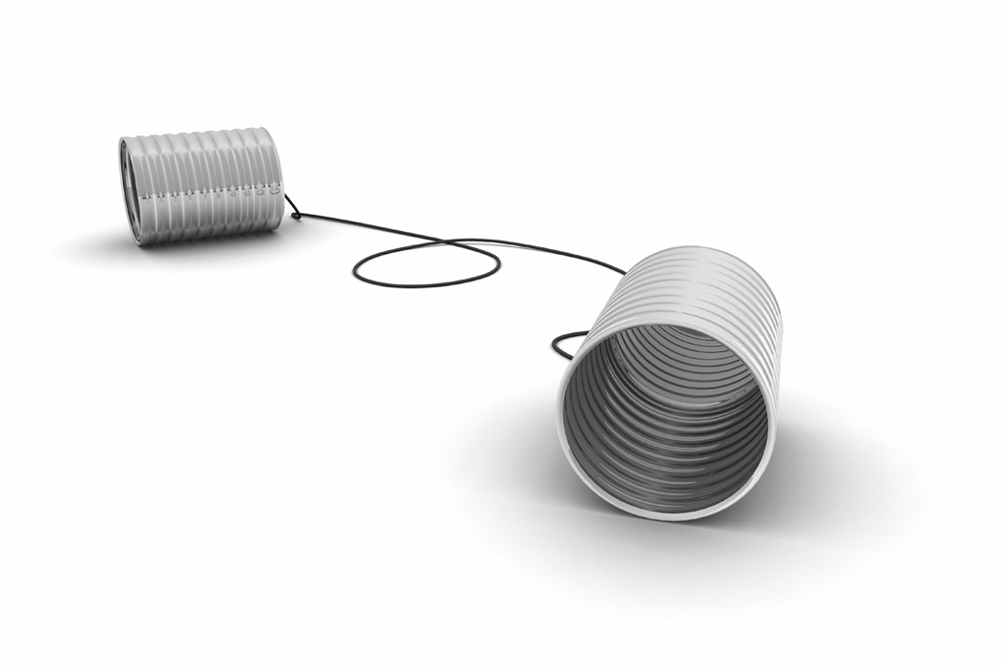
What is Cloud Computing ?
What do they say ?

Slide 5
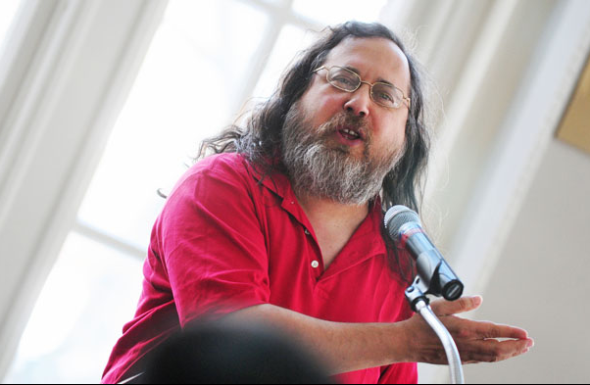
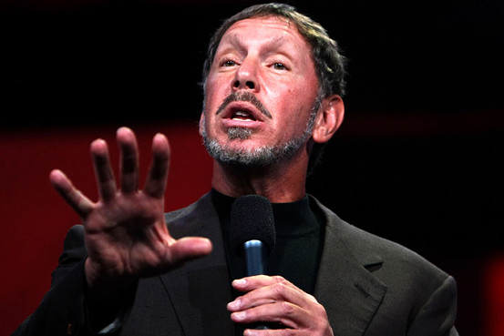
Cloud Disclaimers
Talk from Oracle CEO Larry Ellison
We’ve redefined Cloud Computing to include everything that we already do. I don’t understand what we would do differently other than change the wording of some of our ads.
Talk from Rich Stallman
It's stupidity. It's worse than stupidity: it's a marketing hype campaign. Somebody is saying this is inevitable – and whenever you hear somebody saying that, it's very likely to be a set of businesses campaigning to make it true.

Slide 6

Cloud Definitions
Definition from NIST (National Institute of Standards and Technology)
Cloud computing is a model for enabling convenient, on-demand network access to a shared pool of configurable computing resources (e.g., networks, servers, storage, applications, and services) that can be rapidly provisioned and released with minimal management effort or service provider interaction.
This cloud model promotes availability and is composed of five essential characteristics, three service models, and four deployment models.

Slide 7
Definition from NIST (National Institute of Standards and Technology)
Cloud computing is a model for enabling convenient, on-demand network access to a shared pool of configurable computing resources (e.g., networks, servers, storage, applications, and services) that can be rapidly provisioned and released with minimal management effort or service provider interaction.
This cloud model promotes availability and is composed of five essential characteristics, three service models, and four deployment models.

Slide 8
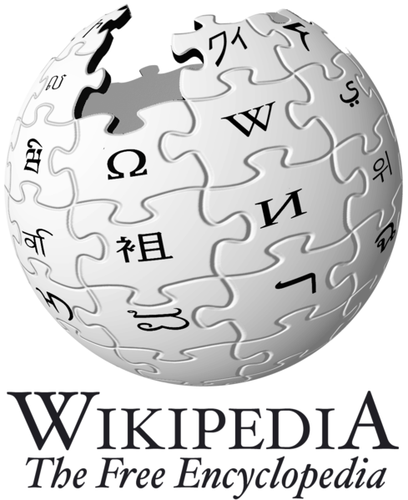
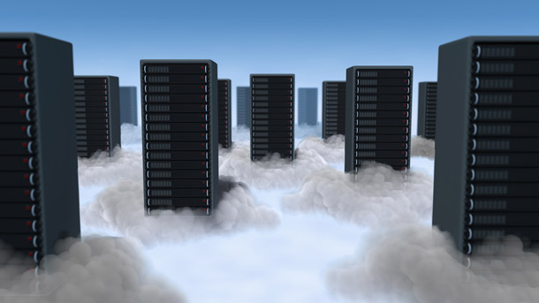
Cloud Definitions
Definition from Wikipedia
Cloud computing is Internet-based computing, whereby shared resources, software, and information are provided to computers and other devices on demand, like the electricity grid.
Cloud computing is a style of computing in which dynamically scalable and often virtualized resources are provided as a service over the Internet.

Slide 9
Definition from Wikipedia
Cloud computing is Internet-based computing, whereby shared resources, software, and information are provided to computers and other devices on demand, like the electricity grid.
Cloud computing is a style of computing in which dynamically scalable and often virtualized resources are provided as a service over the Internet.

Slide 10
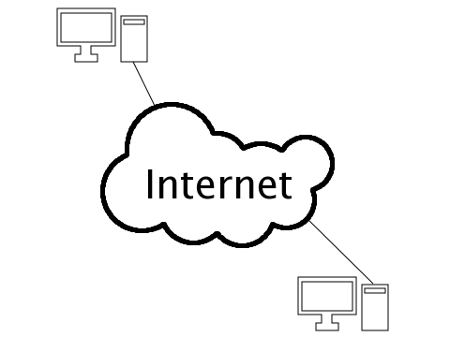
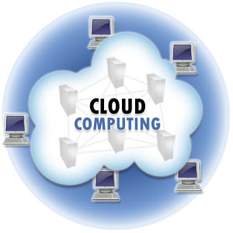
Cloud Definitions
Definition from Whatis.com
The name cloud computing was inspired by the cloud symbol that's often used to represent the Internet in flowcharts and diagrams. Cloud computing is a general term for anything that involves delivering hosted services over the Internet.
Definition from Whatis.com
The name cloud computing was inspired by the cloud symbol that's often used to represent the Internet in flowcharts and diagrams. Cloud computing is a general term for anything that involves delivering hosted services over the Internet.

Slide 11

Cloud Definitions
Definition from Berkeley
Cloud Computing refers to both the applications delivered as services over the Internet and the hardware and systems software in the datacenters that provide those services.
The services themselves have long been referred to as Software as a Service (SaaS), so we use that term. The datacenter hardware and software is what we will call a Cloud.
When a Cloud is made available in a pay-as-you-go manner to the public…… The service being sold is Utility Computing.

Slide 12
Definition from Berkeley
Cloud Computing refers to both the applications delivered as services over the Internet and the hardware and systems software in the datacenters that provide those services.
The services themselves have long been referred to as Software as a Service (SaaS), so we use that term. The datacenter hardware and software is what we will call a Cloud.
When a Cloud is made available in a pay-as-you-go manner to the public…… The service being sold is Utility Computing.

Slide 13
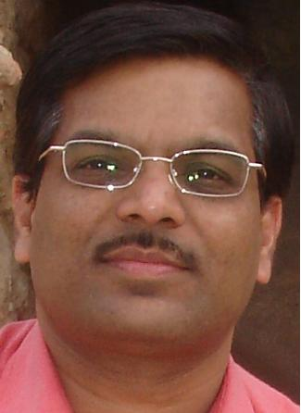
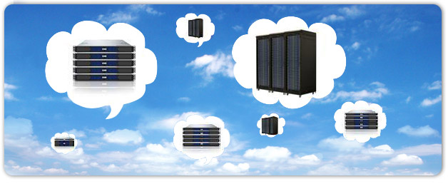
Cloud Definitions
Definition from Buyya
A Cloud is a type of parallel and distributed system consisting of a collection of interconnected and virtualized computers that are dynamically provisioned and presented as one or more unified computing resources based on service-level agreements established through negotiation between the service provider and consumers.

Slide 14
Definition from Buyya
A Cloud is a type of parallel and distributed system consisting of a collection of interconnected and virtualized computers that are dynamically provisioned and presented as one or more unified computing resources based on service-level agreements established through negotiation between the service provider and consumers.

Slide 15

In Our Humble Opinion
Cloud computing is a paradigm of computing, a new way of thinking about IT industry but not any specific technology.
Central ideas
Utility Computing
SOA - Service Oriented Architecture
SLA - Service Level Agreement
Properties and characteristics
High scalability and elasticity
High availability and reliability
High manageability and interoperability
High accessibility and portability
High performance and optimization
Enabling techniques
Hardware virtualization
Parallelized and distributed computing
Web service

Slide 16
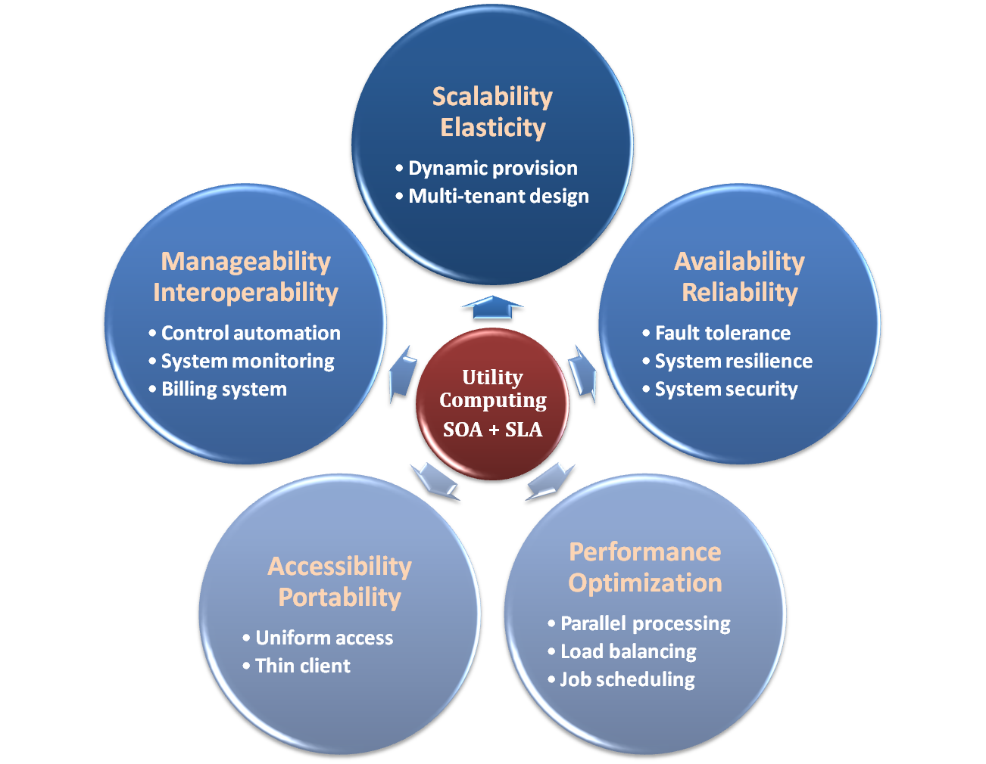
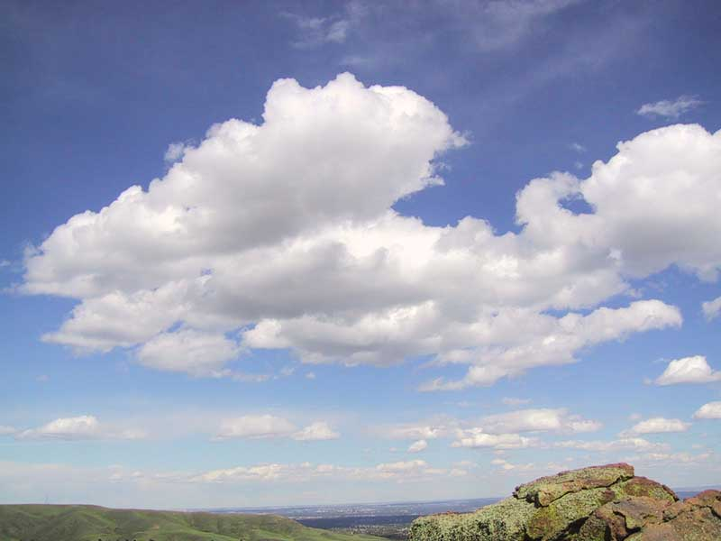
Properties and Characteristics

Slide 17
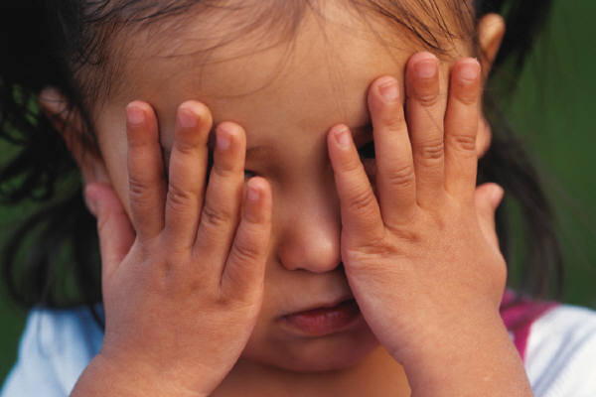
Central Ideas
Don’t tell me details!!
I DON’T CARE!!

Slide 18
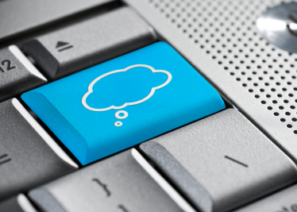
Central Ideas
Perspective from user :
Users do not care about how the works are done
Instead, they only concern about what they can get
Users do not care about what the provider actually did
Instead, they only concern about their quality of service
Users do not want to own the physical infrastructure
Instead, they only want to pay as many as they used
What dose user really care ?
They only care about their “Service”

Slide 19
Utility Computing
One service provisioning model
Service provider makes computing resources and infrastructure management available to the customer as needed, and charges them for specific usage rather than a flat rate.
Like other types of on-demand computing , the utility model seeks to maximize the efficient use of resources and/or minimize associated costs.

Slide 20
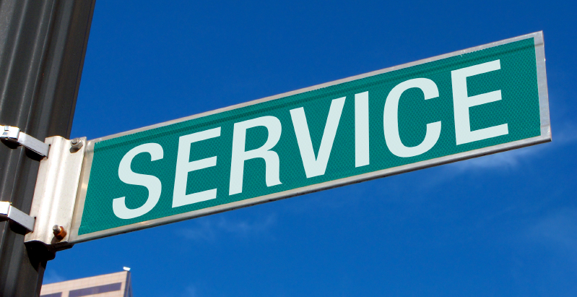
What Is Service?
Service is what you connect together using Web Services.
Service is the endpoint of a connection.
Functionalities of service :
A service should be well-defined
A service should be self-contained
A service should not depend on the context or state of other services.

Slide 21
What Is Web Service?
Definition :
Web service is self-describing and stateless modules that perform discrete units of work and are available over the network
Web service providers offer APIs that enable developers to exploit functionality over the Internet, rather than delivering full-blown applications
Web Services Description Language (WSDL) :
Expressed in XML which include both data type and messages
Four types of operations :
One-way - Messages sent without a reply required
Request & response - Sending and replying messages
Solicit response - A request for a response
Notification - Messages sent to multiple receivers

Slide 22
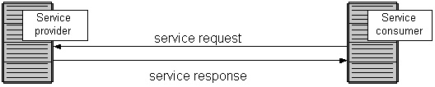
Service Oriented Architecture
Definition
Service Oriented Architecture (SOA) is essentially a collection of services which communicate with each other
Contain a flexible set of design principles used during the phases of systems development and integration
Provide a loosely-integrated suite of services that can be used within multiple business domains
Approach
Usually implemented by Web Service model

Slide 23
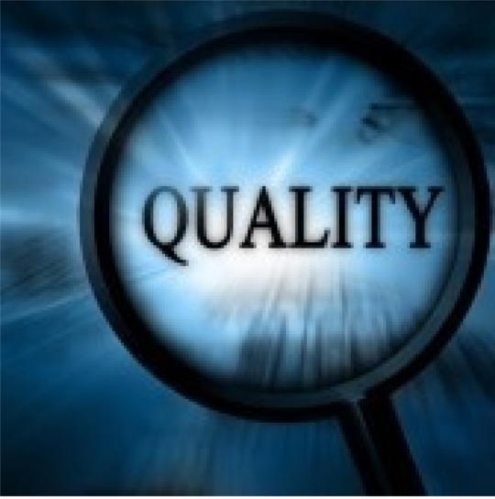
Quality Of Service
Original definition
Quality of Service (QoS) is a set of technologies for managing network traffic in a cost effective manner to enhance user experiences for home and enterprise environments.
Now QoS becomes to a broad term that is used following areas :
Customer care evaluations
Technological evaluations

Slide 24
Quality Of Service
Customer care evaluations
QoS is usually measured in terms of issues that have a direct impact on the experience of the customer
Only issues that produce a negative effect on the goods and services received by the customer come under scrutiny
Technological evaluations
QoS has to do with the efficient operation of various systems
This can lead to adjusting procedures or adapting software programs and code to achieve the desired effect while making a more efficient use of available resources

Slide 25
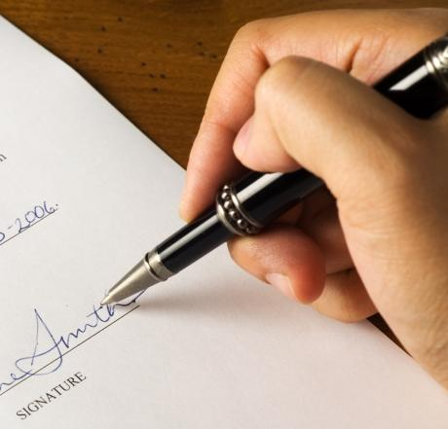
Service Level Agreement
Definition
A service-level agreement (SLA) is a contract between a network service provider and a customer that specifies, usually in measurable terms (QoS), what services the network service provider will furnish
Common content in contract
Performance guarantee metrics
Up-time and down-time ratio
System throughput
Response time
Problem management detail
Penalties for non-performance
Documented security capabilities

Slide 26

Scalability & Elasticity
Give me the world without limitation!!

Slide 27
Scalability & Elasticity
What is scalability ?
A desirable property of a system, a network, or a process, which indicates its ability to either handle growing amounts of work in a graceful manner or to be readily enlarged.
What is elasticity ?
The ability to apply a quantifiable methodology that allows for the basis of an adaptive introspection with in a real time infrastructure.
But how to achieve these properties ?
Dynamic provisioning
Multi-tenant design

Slide 28
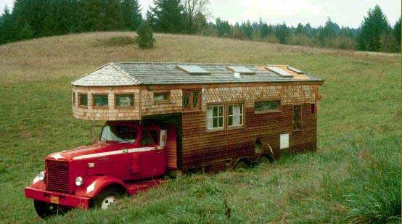
Dynamic Provisioning
What is dynamic provisioning ?
Dynamic Provisioning is a simplified way to explain a complex networked server computing environment where server computing instances are provisioned or deployed from a administrative console or client application by the server administrator, network administrator, or any other enabled user.

Slide 29
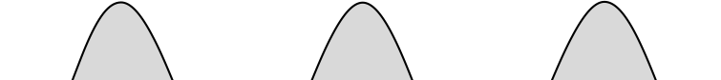
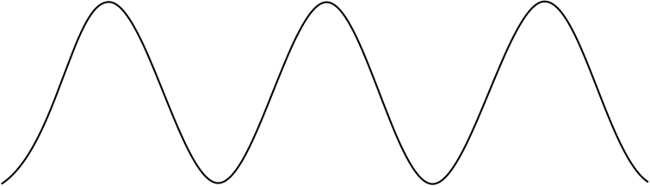
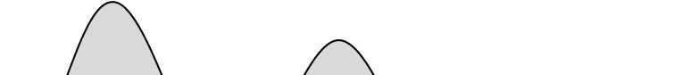

Dynamic Provisioning
In traditional computing model, two common problems :
Underestimate system utilization which result in under provision
Loss Revenue
Resources
Capacity
Resources
Demand
Capacity
1
2
3
Demand
Loss Users
Resources
Capacity
1
2
3
Time (days)
Demand
1
2
3

Slide 30
Dynamic Provisioning
Overestimate system utilization which result in low utilization
How to solve this problem ??
Dynamically provision resources
Capacity
Resources
Unused resources
Demand
Time

Slide 31
Dynamic Provisioning
Cloud resources should be provisioned dynamically
Meet seasonal demand variations
Meet demand variations between different industries
Meet burst demand for some extraordinary events
Resources
Capacity
Resources
Capacity
Demand
Demand
Time
Time

Slide 32
Multi-tenant Design
What is multi-tenant design ?
Multi-tenant refers to a principle in software architecture where a single instance of the software runs on a server, serving multiple client organizations.
With a multi-tenant architecture, a software application is designed to virtually partition its data and configuration thus each client organization works with a customized virtual application instance.
Client oriented requirements :
Customization
Multi-tenant applications are typically required to provide a high degree of customization to support each target organization's needs.
Quality of service
Multi-tenant applications are expected to provide adequate levels of security and robustness.

Slide 33
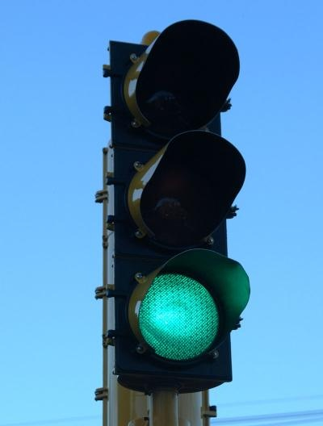
Availability & Reliability
Data Never Loss Machine Never Fail

Slide 34
Availability & Reliability
What is availability ?
The degree to which a system, subsystem, or equipment is in a specified operable and committable state at the start of a mission, when the mission is called for at an unknown time.
Cloud system usually require high availability
Ex. “Five Nines” system would statistically provide 99.999% availability
What is reliability ?
The ability of a system or component to perform its required functions under stated conditions for a specified period of time.
But how to achieve these properties ?
Fault tolerance system
Require system resilience
Reliable system security

Slide 35
Fault Tolerance
What is fault tolerant system ?
Fault-tolerance is the property that enables a system to continue operating properly in the event of the failure of some of its components.
If its operating quality decreases at all, the decrease is proportional to the severity of the failure, as compared to a naively-designed system in which even a small failure can cause total breakdown.
Four basic characteristics :
No single point of failure
Fault detection and isolation to the failing component
Fault containment to prevent propagation of the failure
Availability of reversion modes

